Slide 1
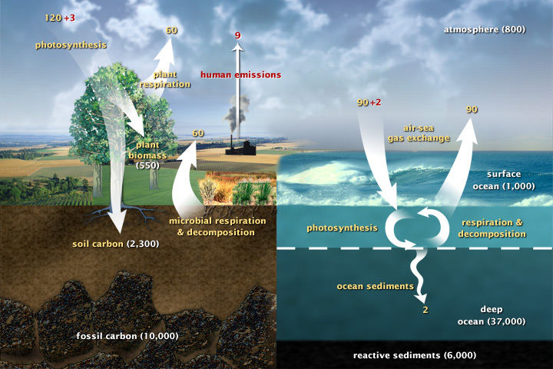
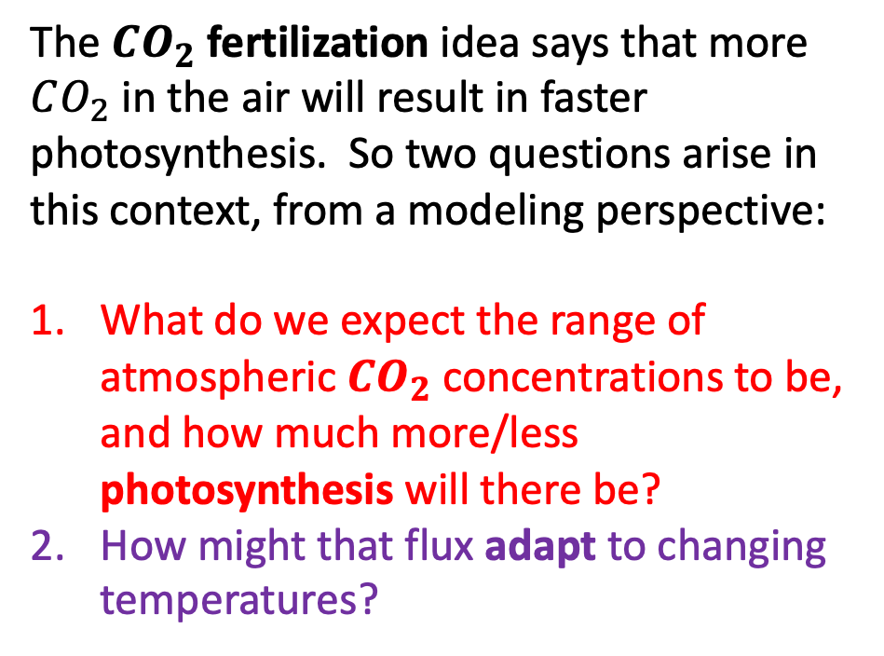
Carbon fluxes in Earth’s climate system
The $CO_{2}$ fertilization idea says that more $CO_{2}$ in the air will result in faster photosynthesis. So two questions arise in this context, from a modeling perspective:
What do we expect the range of atmospheric $CO_{2}$ concentrations to be, and how much more/less photosynthesis will there be?
How might that flux adapt to changing temperatures?
Fluxes as of year 2005, when atmospheric CO₂ was about 415 ppm

Slide 2
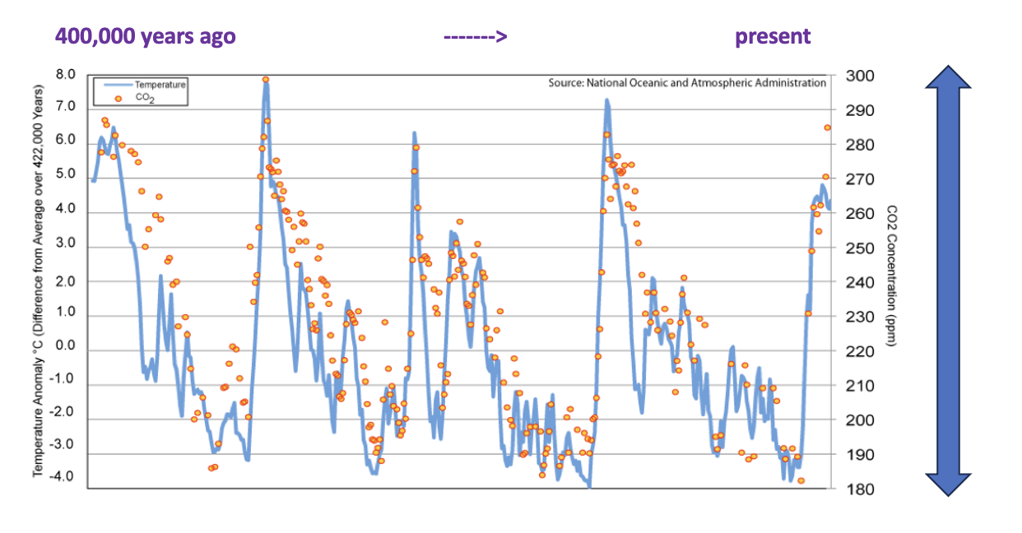
How $CO_{2}$ changed in the Pleistocene
Notes:
Predict the temperature if CO2 continues to rise. If we reduce CO2 emissions to zero.

Slide 3
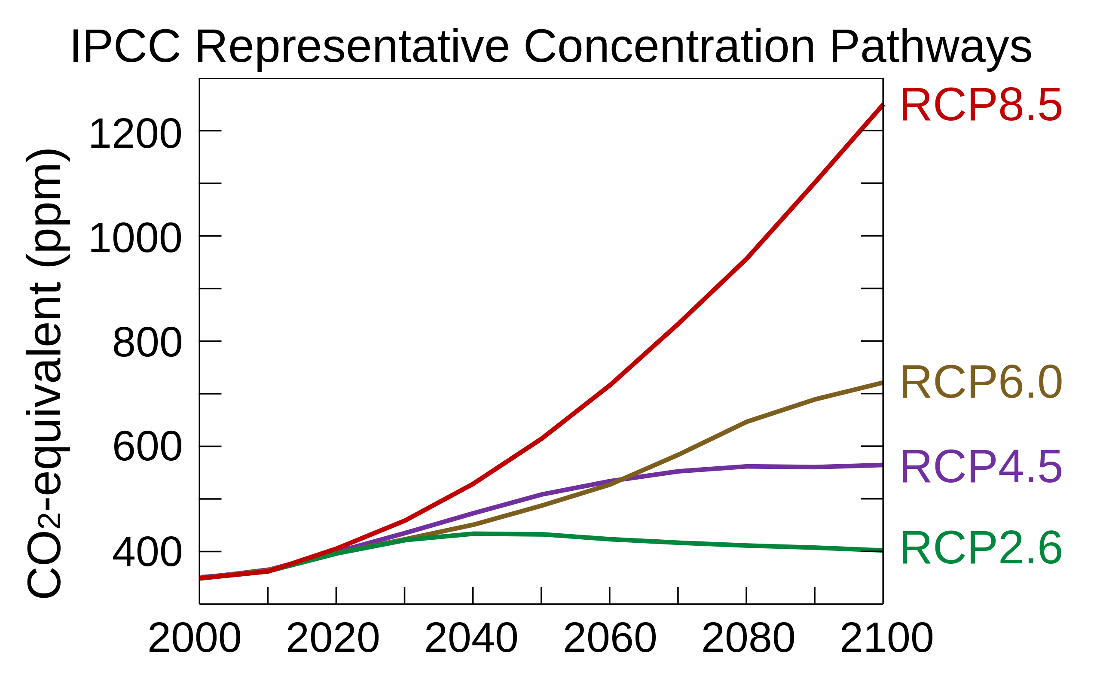
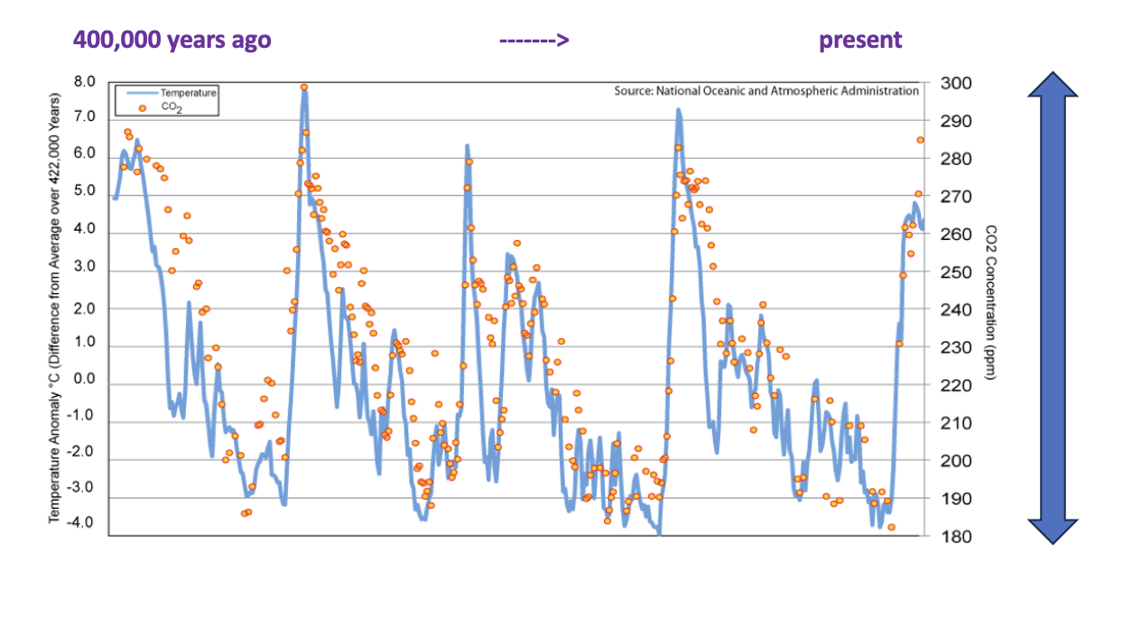
How we think $CO_{2}$ will change in the Anthropocene
RCP 6.0
RCP 4.5
Notes:
Predict the temperature if CO2 continues to rise. If we reduce CO2 emissions to zero.

Slide 4
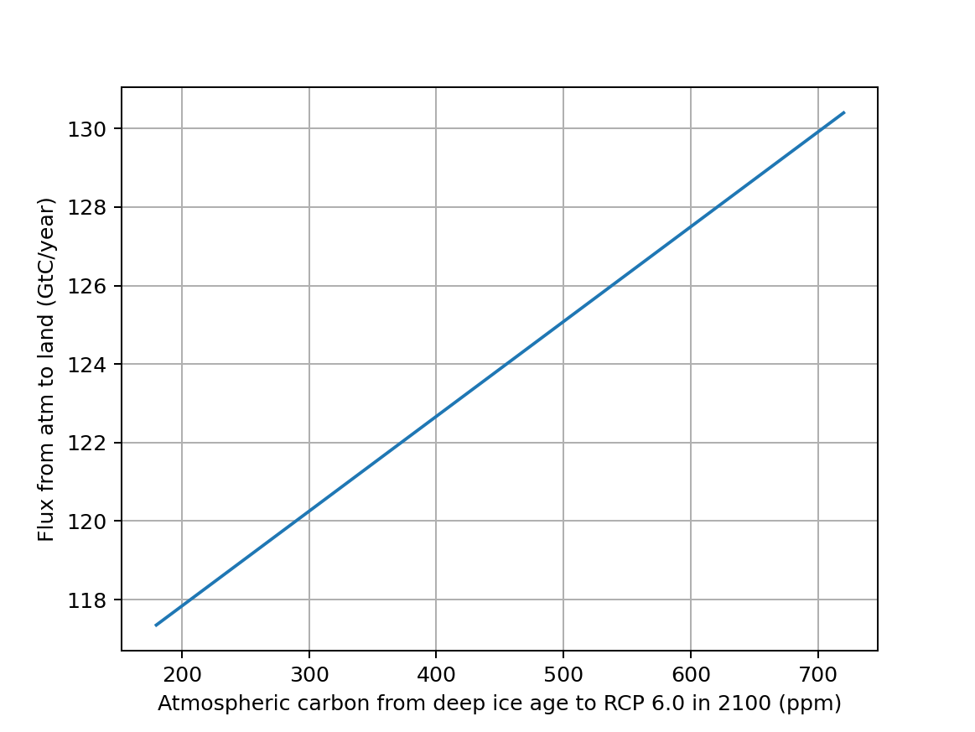
Here’s a guess: let the flux be a linear function of the concentration (ppm) of atm CO₂
The positive slope quantifies the idea of CO₂ fertilization
180 ppm
(deep ice age)
414 ppm
(in year 2005)
720 ppm
(RCP 6.0 in year 2100)

Slide 5
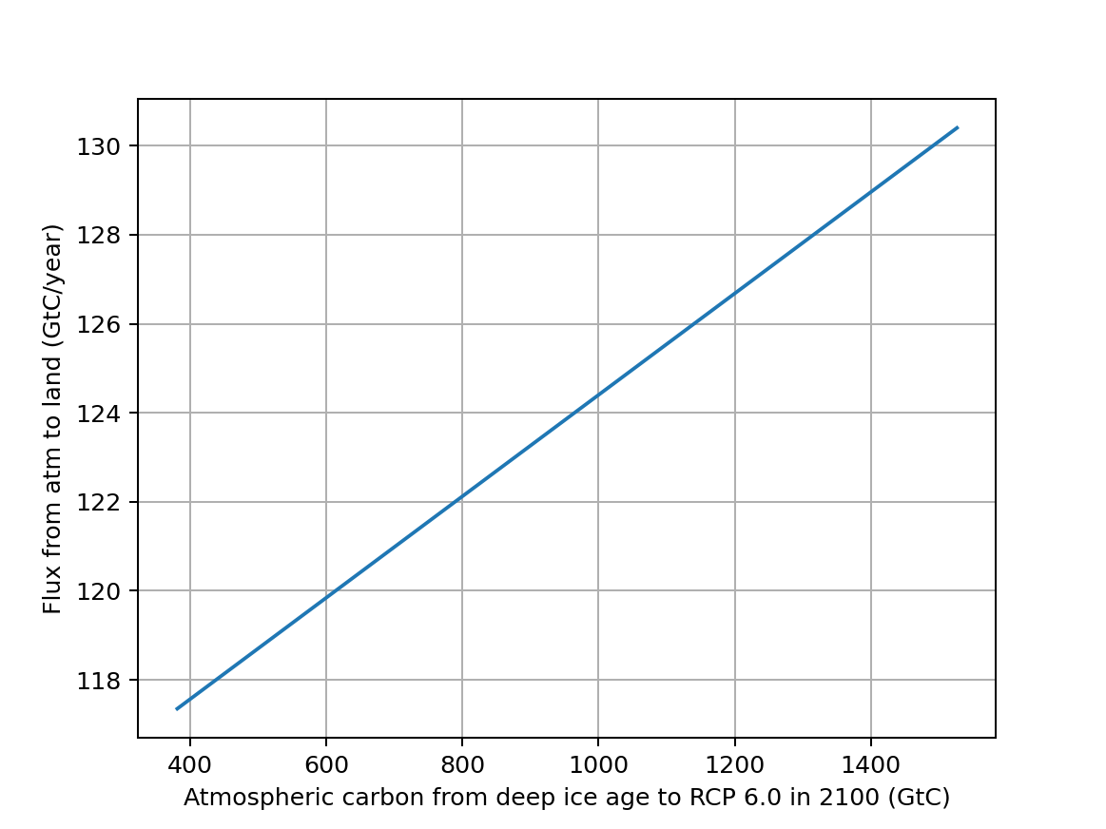
Here’s a guess: let the flux be a linear function of the amount (GtC) of atm CO₂
The positive slope quantifies the idea of CO₂ fertilization
180 x 2.12 = 382 GtC
(deep ice age)
720 x 2.12 = 1500 GtC
(RCP 6.0 in year 2100)

Slide 6
In other words, this is where we were 150 years ago, ”pre-industrial” times …
The positive slope quantifies the idea of CO₂ fertilization
180 x 2.12 = 382 GtC
(deep ice age)
720 x 2.12 = 1500 GtC
(RCP 6.0 in year 2100)

Slide 7
… and his is where we were in 2005 when that figure was made …
The positive slope quantifies the idea of CO₂ fertilization
180 x 2.12 = 382 GtC
(deep ice age)
720 x 2.12 = 1500 GtC
(RCP 6.0 in year 2100)

Slide 8
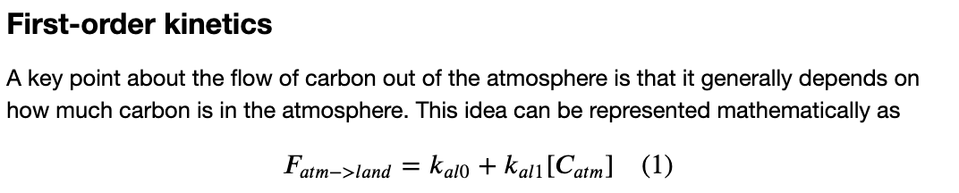
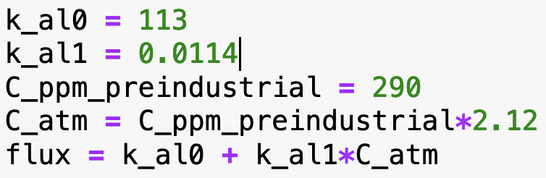
The math (and Python code) behind this
Should produce a flux of 120 GtC/year when the concentration of CO₂ is 290 ppm, but 123 when

Slide 9
Carbon fluxes in Earth’s climate system
The $CO_{2}$ fertilization idea says that more $CO_{2}$ in the air will result in faster photosynthesis. So two questions arise in this context, from a modeling perspective:
What do we expect the range of atmospheric $CO_{2}$ concentrations to be, and how much more/less photosynthesis will there be?
How might that flux adapt to changing temperatures?

Slide 10
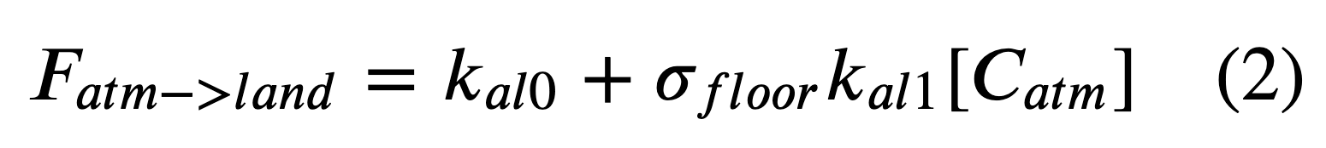
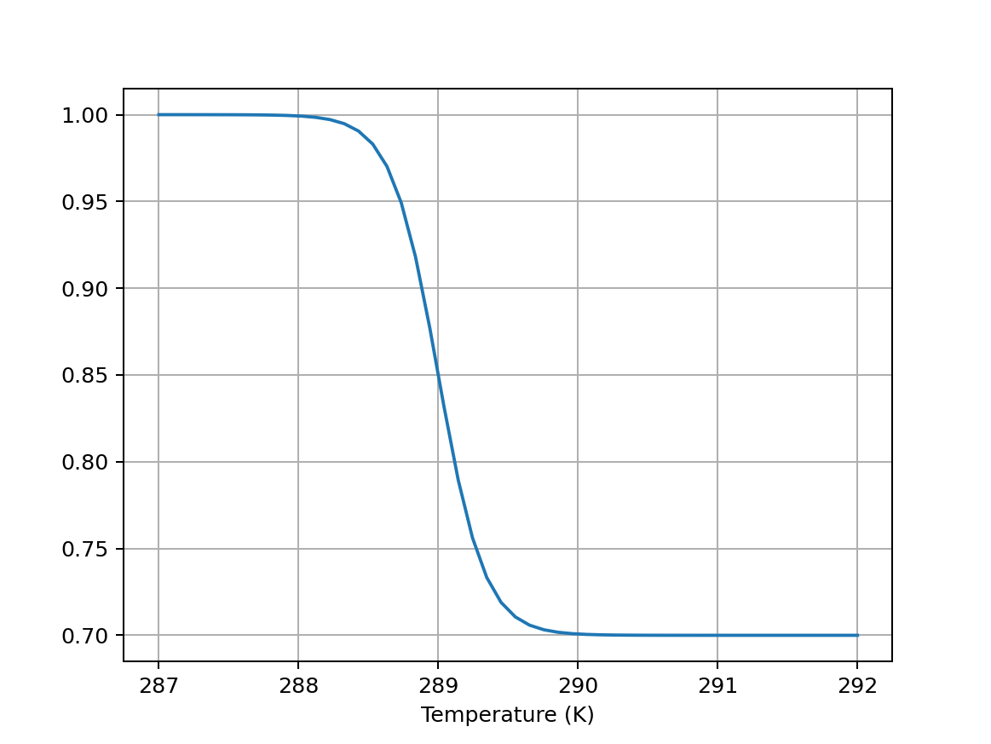
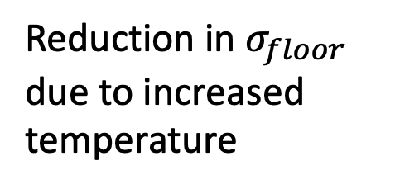
Adaptive first-order kinetics (to include feedback effects)
Instead of this:
We’ll use this:
Reduction in $σ_{floor}$ due to increased temperature

Slide 11
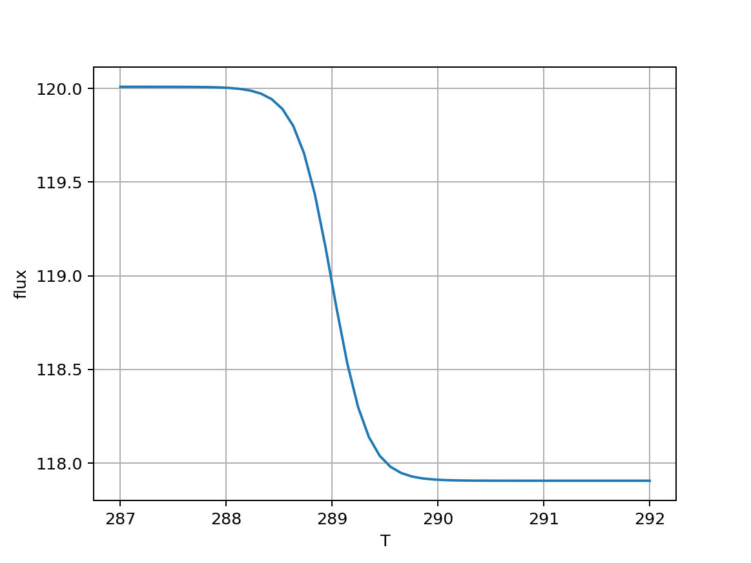
Adaptive first-order kinetics (to include feedback effects)
Instead of this:
We’ll use this:
Reduction in flux due to increased temperature

Slide 12
Carbon fluxes in Earth’s climate system
Drops from 123 to 118 GtC/year if temperature goes up

